Slide 1









Take 25, a campaign of the
National Center For Missing & Exploited Children
Notes:
Hello everyone. Thank you for joining us today to discuss the issue of child safety. This presentation, along with the resources I will mention, has been provided by the National Center for Missing & Exploited Children (NCMEC).
As educators, it is not only our responsibility to teach children, but to also ensure that they are provided with the tools necessary to help keep them safer. The National Center has the resources to help us do that.
Over the next 30 minutes I will give a brief overview of the National Center, the issue of missing children, and the tools available for educators that can help us begin important discussions with students.

Slide 2

National Center for
Missing and Exploited Children
A private, nonprofit 501(c)(3) organization
NCMEC’s mission is to help find missing children; help prevent child abduction and sexual exploitation; and assist victims of child abduction and sexual exploitation, their families, and the professionals who serve them
Notes:
The National Center for Missing & Exploited Children was created in 1984 and is a private, nonprofit 501 (c)(3) organization. It serves as the nation’s clearinghouse on issues related to missing and exploited children while operating the toll-free 24-hour national missing children’s hotline, 1-800-THE-LOST.
The National Center’s mission is to help find missing children; help prevent child abduction and sexual exploitation; and assist victims of child abduction and sexual exploitation, their families, and the professionals who serve them.
Sometimes when we think about missing and exploited children we don’t realize how large the problem is or how these issues impact our communities and children.

Slide 3
The Issue of Missing Children
Nearly 800,000 children are reported to law enforcement as missing each year
More than 2,000 children are reported as missing to law enforcement every day
More than 200,000 of these children are victims of family abductions each year
More than 58,000 of these children are victims of non-family abduction each year
Notes:
Statistics from the U.S. Department of Justice help shed light on the problem. In a one year period
Nearly 800,000 children are reported as missing to law enforcement. That’s more than 2,000 children per day.
[Broken down by race, 1 in 5 of these children are African American and 1 in 5 are Hispanic.]
Of these children, more than 200,000 children are victims of family abductions, occuring when children are taken by a non-custodial parent or guardian. Typically, family abductions are not motivated by love, but rather by anger and revenge.
More than half of the 800,000 children that are reported to law enforcement as missing are runaways.
More than 58,000 of these children are victims of non-family abductions. Every year, 115 of these children are the victims of “stereotypical” kidnappings.
Thankfully the majority are recovered quickly.
All of this information is vital in framing the scope of the problem. It is also important that we look at cases where the children were not successfully taken, or attempted abductions. NCMEC is the only agency that tracks attempted abductions by receiving leads from law enforcement and recognizing trends.

Slide 4
Attempted Abductions
Out of over 7,000 confirmed attempted abductions, analysis shows…
69% of victims are female
41 % are between the ages of 10-14
35% occur while a child is walking along to/from school, the school bus or riding a bicycle
35% occur between the hours of 2pm through 7pm on a weekday
Suspects: 96% are male, 48% are white
72 % involve a vehicle
Data from 7,000 + incidents known to NCMEC from February 1,2005 through January 31, 2012
Notes:
To understand these types of situations and develop solutions, the National Center conducted a study and analyzed more than 7,000 attempted abductions cases for the 7 year period from February 2005 to March 2012. Here’s what they found:
-69% of victims are female
-41 % are between the ages of 10-14
-35% occur while a child is walking to/from school, the school bus or riding a bicycle
-35% occur between the hours of 2pm through 7pm on a weekday
-96% of the suspects are male, and 48% are white
-72 % involve a vehicle
The five most common lures included:
-Offering the child a ride
-Offering the child candy or sweets
-Showing the child an animal or asking for help finding an animal
-Offering the child money
-Asking the child for a ride
The good news is that many of the children knew how to respond and were able to escape a possible abduction.

Slide 5
The Good News
Of the confirmed incidents…
53% walked or ran away from the suspect and had no physical contact
28% reported some type of reaction such as yelling, kicking, pulling away, or otherwise attracting attention
19% involved either a Good Samaritan or parent becoming involved in rescuing the child
Notes:
Of the confirmed incidents:
-53% walked or ran away from the suspect and had no physical contact
-28% reported some type of reaction such as yelling, kicking, pulling away, or otherwise attracting attention
-19% involved either a Good Samaritan or parent becoming involved in rescuing the child
This shows us that children have been taught what to do if they ever come across this type of situation.

Slide 6
Communication is Key
Children learn through repetition of messages
Regular conversations create a second nature awareness for children and youth
Build trust
Create teachable moments for children and youth
Encourage positive communication with students and youth
Notes:
Communication is key. Positive communication engages children in positive behaviors. Parents and guardians need to foster regular dialogue about personal safety with children. By developing positive and ongoing conversations about personal safety and repeating safety messages, children will capture the idea and develop a “second nature” of awareness. It is important to build trusting relationships with children. Trust allows children to express their feelings and share situations that may make them feel uncomfortable.
So as educators, how do we begin these safety conversations?
We know it’s not always that simple. And that’s why the National Center created the Take 25 Campaign to help families and communities take that first step.

Slide 7
Take 25 Campaign
With a focus on prevention, Take 25 provides you with the tools and resources to help initiate an ongoing dialogue about safety with the children in your community.
Notes:
Take 25 is a national grassroots campaign that encourages parents, guardians, law enforcement, educators, and others to talk to children about safety. Created in commemoration of National Missing Children’s Day, and annually recognized on May 25th, this day serves as a time to renew efforts to reunite missing children with their families -- remember those who are still missing -- and make child safety a national priority. With a focus on prevention, Take 25 provides you with the tools and resources to help initiate an ongoing dialogue about safety with the children in your community.
Each May, individuals and organizations host safety events to raise awareness of local missing children’s issues. Examples of popular Take 25 events include safety presentations, child ID events, community fairs, and distribution of safety resources. NCMEC also provides event planning resources, sample presentations, and other promotional items to help facilitate your Take 25 events.
Getting involved is easy! Take 25 provides the tools and resources necessary to promote the campaign at your school.

Slide 8


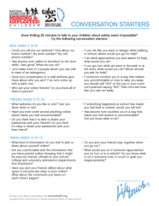

Campaign Resources
Take 25 offers free bilingual resources to event organizers and the public. These include
Safety Tips*
Conversation Starters
Bookmarks
Child ID Kits
Promotional Posters
…and much more!
*Also available in French, Chinese, Korean, and Arabic. Braille upon request.
Notes:
Take 25’s corporate sponsor, Lifetouch, makes it possible for NCMEC to provide communities with free bilingual (English/Spanish) materials. These include:
-Safety tips in multiple languages that feature 25 tips for safety at home, going to and from school, while out and about and on the net.
-Conversation starters for parents, guardians, and trusted adults to begin discussions around safety.
-Bookmarks feature NCMEC’s four rules for safety in English and Spanish.
-Child ID Kits include a space for a photo, descriptive information about the child, and fingerprints.
-Emergency Contact For Parents is a document for parents to include emergency contact information
NCMEC also offers Mini-Lessons to use in classrooms.

Slide 9
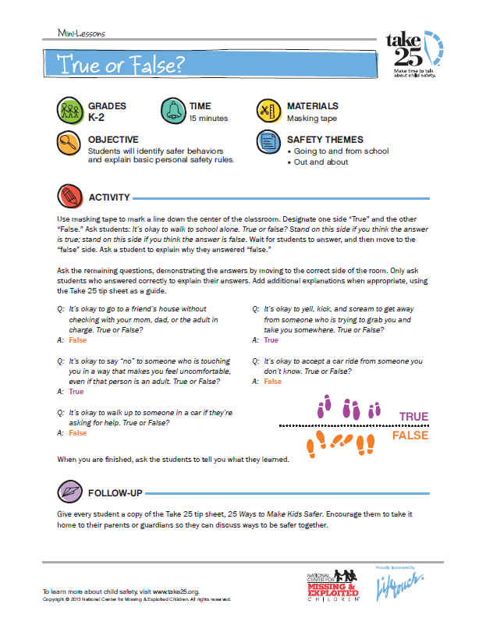
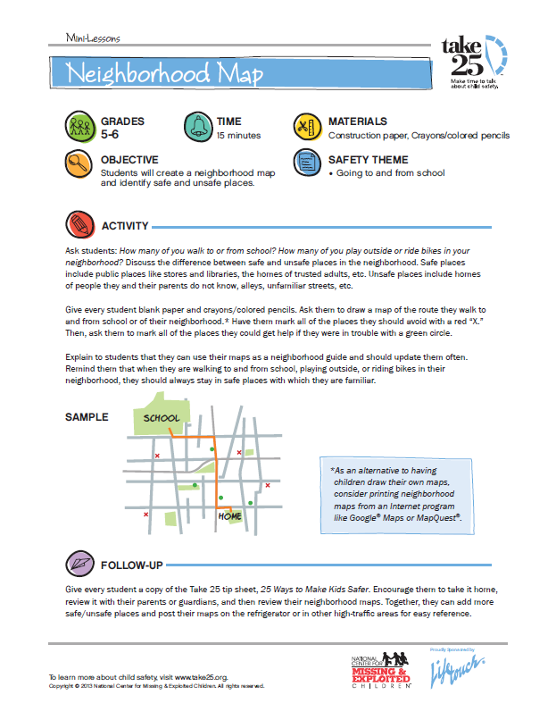
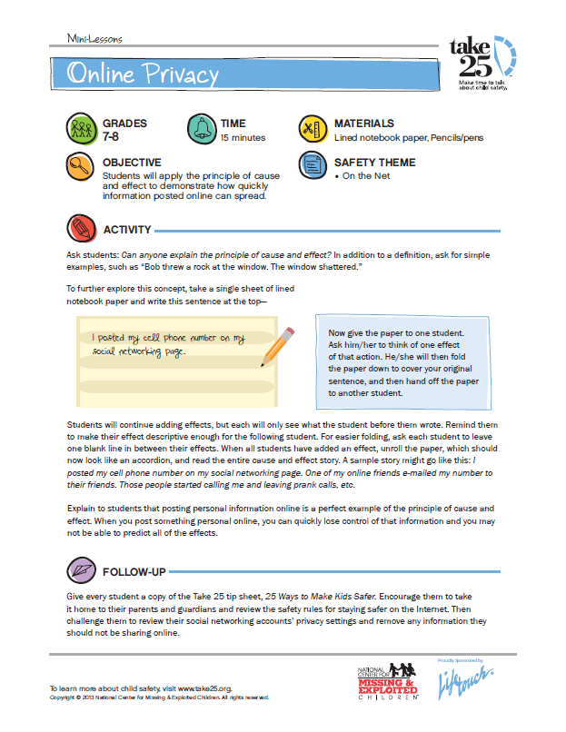
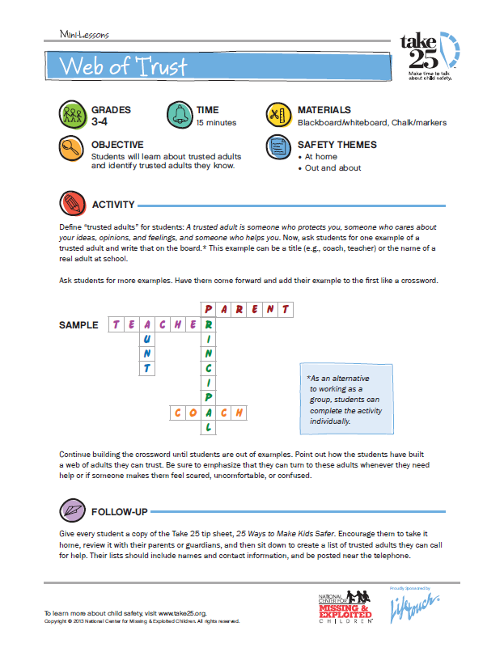
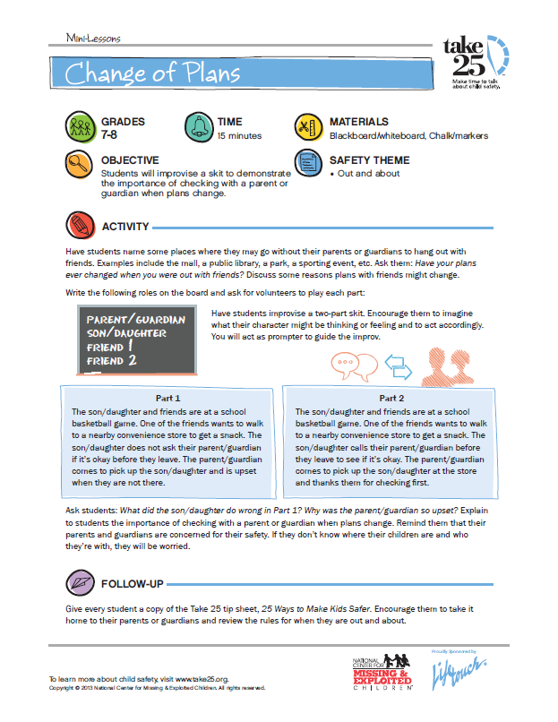
Mini-Lessons
Notes:
Mini-Lessons are 15-20 minute activities for children in grades K-8. These lessons can be utilized along with Take 25 Safety Tips and can be delivered in both classroom and community settings. They highlight themes of safety at home, going to and from school, while out and about and on the net. This resource is available in English and Spanish.
Other resources that can be distributed are Conversation Starters, Safety Tips, Child IDs, and Emergency Contact For Parents.

Slide 10
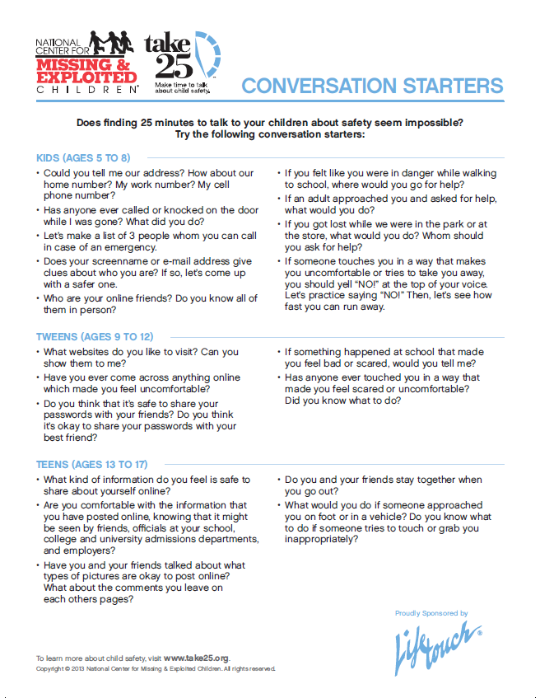
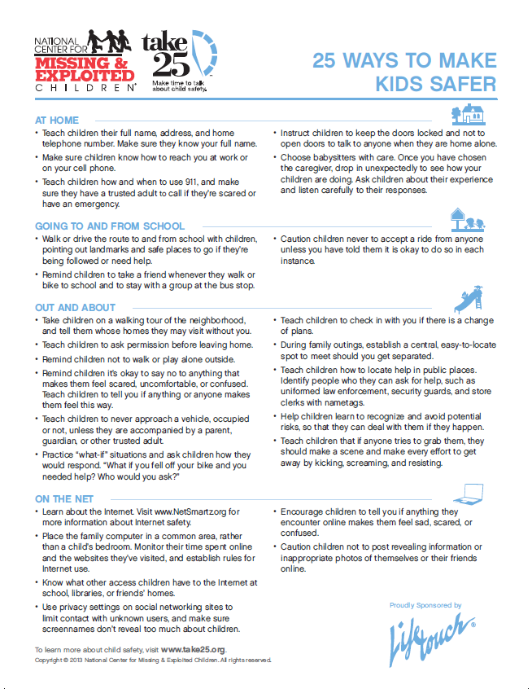
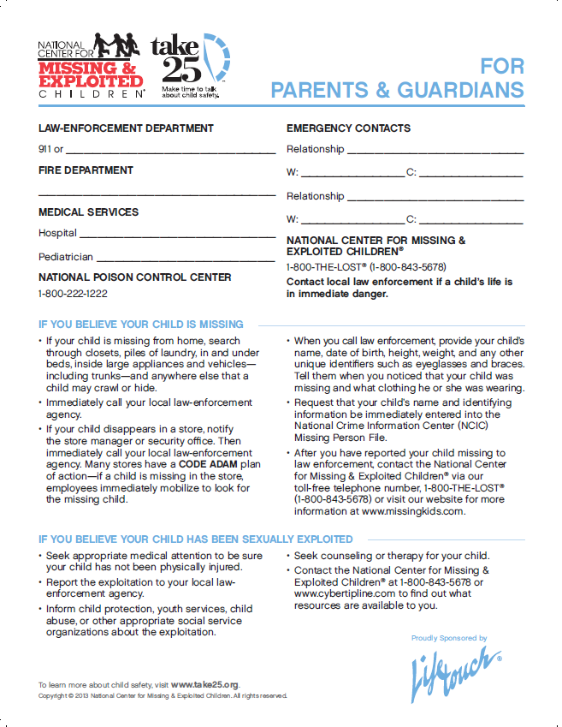
Take Home Resources
Notes:
The Emergency Contact For Parents is a useful document for parents to include emergency contact information. It can be kept on the refrigerator, near the phone, or in another easily accessible location.
The Safety Tips are available in various languages and feature 25 tips for safety at home, going to and from school, while out and about and on the net.
The Conversation Starters include 25 questions which parents, guardians, or trusted adults can ask to begin conversations around safety.
Take 25 also offers Child Identification kits which include space for a photo, descriptive information, and fingerprints. This is also available in English and Spanish.
Other resources that can be distributed along with the Child Identification kits are the Conversation Starters, Safety Tips, and Emergency Contact For Parents.
All of these resources can be sent home with students or can be made available for parents at an evening meeting. Take 25 provides the necessary tools to plan and execute a successful presentation.

Slide 11

Parent Involvement
Provides understanding of the issue of missing and exploited children
The importance of parents talking to children about safety
The resources available for parents to start these conversations
Notes:
Parent involvement is key when delivering Take 25 to students. That’s why many of the resources have a take-home component. In addition to the resources I’ve mentioned, Take 25 also provides resources that can be shared during parent meetings.
This 30 minute Parents Presentation was created specifically for parents, guardians, or other care givers. It provides an understanding of the issue of missing and exploited children, stresses the importance of parents talking to their children about safety, and includes the Take 25 resources available to start these conversations. Consider planning an event at your school to deliver this presentation and provide Take 25 materials.
As safety concerns don’t just cover the real world, NCMEC also provides resources and presentations for younger children, tweens, teens, and parents that focus on Internet safety.

Slide 12
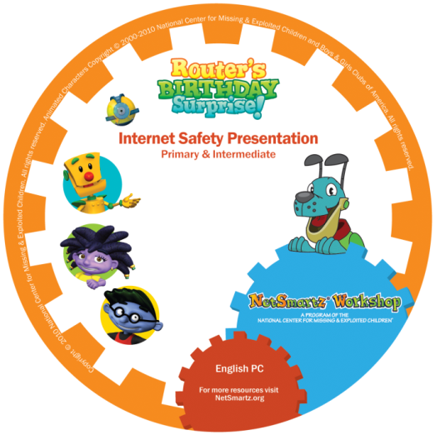


Internet Safety Presentations
Available for download at www.netsmartz.org/Presentations
Notes:
Through the NetSmartz Workshop, a program of the National Center for Missing & Exploited, children, tweens, and teens are introduced to important Internet safety lessons like sharing personal information online, sexting, and cyberbullying.
These resources can be used year round and in conjunction with Take 25 materials to teach parents and children about online and real world safety.
For younger children use Router’s Birthday Surprise. This presentation includes easy-to-remember safety rules, age-appropriate explanations of online and/or personal safety risks, and animated video combined with engaging presenter’s dialogue.
For tweens and teens, two 30-minute PowerPoint presentations contain animated and documentary-style videos, candid, thought-provoking discussions, practical advice, and free resources.
For parents and communities, a 45-minute PowerPoint presentation for parents and guardians of children ages 5-17 includes facts of online risks, statistics, videos, and other resources as well as tips for keeping children safer online.

Slide 13
Get Involved:
Host a Take 25 Event
A Take 25 event can be any opportunity to engage students and their families on the importance of child safety, including:
Give a Take 25 Mini Lesson
Educate Students and Parents about Internet Safety
Host an Assembly
Share Take 25 Safety Tips
Distribute Take 25 Bookmarks
Organize a Child ID Event
Visit www.take25.org/host to register your Take 25 event
Notes:
Today you’ve learned about missing and exploited children and the NCMEC prevention resources available. I urge you to get involved with Take 25 and bring the message of safety into your schools, day cares, and afterschool programs.
Remember, a Take 25 event can be any opportunity that engages students and their families on the importance of child safety, including:
-Give a Take 25 Mini Lesson. Mini lessons offer a quick 10-15 minute activity for students which reinforce the four rules of safety.
-Educate Students and Parents about Internet Safety. Visit www.NetSmartz.org for the downloadable Internet safety presentations I mentioned. Give these during the school day or at evening parent nights.
-Host an Assembly. Discuss relevant child safety issues with students.
-Share Take 25 Safety Tips. Tips can be shared during morning announcements, parent meetings, and other social clubs. Safety pledges can also be sent home to be shared with parents.
-Distribute Take 25 Materials and Bookmarks. Make bookmarks available in your libraries, school office, before and after care, and extracurricular activities throughout the month of May.
-Organize a Child ID Event. Partner with local law enforcement to provide child ID kits to parents.
All of the resources I mentioned earlier are available FREE of charge! Simply register your Take 25 event at www.take25.org/host and ordering materials.

Slide 14

www.Take25.org
www.NetSmartz.org
www.Missingkids.com
Notes:
Your role as an educator is invaluable in helping to keep children safer. I encourage you to join NCMEC in their efforts to help keep children safer and be part of a national movement dedicated to protecting children.
Thank you for taking the time to attend this presentation. The safety of our students/children is a cooperative effort between the school, the community and parents. We appreciate your support. For additional information about the programs mentioned, please visit:
Take 25 Campaign www.take25.org
NetSmartz Workshop www.NetSmartz.org
NCMEC www.missingkids.com
My contact information is [insert phone/email] should you have any additional questions.
Thank you.

